Slide 1

PENGGUNAAN MOTOR LISTRIK
HENDRA MARTA YUDHA
hendramy@univ-tridinanti.ac.id

Slide 2
SISTEM PENILAIAN
PENILAIAN ACUAN NORMAL, PAN
PENILAIAN ACUAN PATOKAN, PAP
KOMBINASI PAN DAN PAP
KOMPONEN PENILAIAN
KEHADIRAN → MINIMAL 80% DARI TOTAL TATAP MUKA
NILAI QUIZ DAN TUGAS-TUGAS
NILAI UJIAN TENGAH SEMESTER
NILAI UJIAN AKHIR SEMESTER
CONTOH PENILAIAN
No
NAMA/NIM
%KEHADIRAN
NTGS
NUTS
NUAS
NILAI AKHIR
≥ 80%
30 %
25%
45%
100%
1.
ALIF/001
78%
100
100
100
E
2.
BATA/002
82%
100
100
E
3.
SHA/003
≥ 80%
10
50
60
A,B,C,or D

Slide 3
MATERI PERKULIAHAN
Macam-macam Motor Listrik
Karakteristik Motor Listrik
Merencanakan penggunaan motor listrik
Pengaturan Motor Listrik
Komponen pengaturan motor
Starting pada motor listrik
Pengaturan Motor DC
UJIAN TENGAH SEMESTER
Pengaturan motor Induksi
Pengaturan motor stepper
pengaturan motor servo
pengereman pada Motor listrik
kerja inverter dalam pengaturan motor induksi
PLC dalam pengaturan motor
aplikasi program PLC untuk pengaturan motor
EVALUASI AKHIR SEMESTER

Slide 4
BUKU ACUAN UTAMA
A TEXT BOOK OF ELECTRICAL TECHNOLOGY
BL THERAJA
DASAR TENAGA LISTRIK
ZUHAL

Slide 5
Macam-macam Motor Listrik

Slide 6

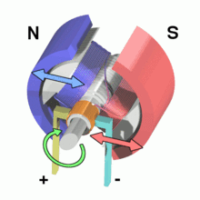
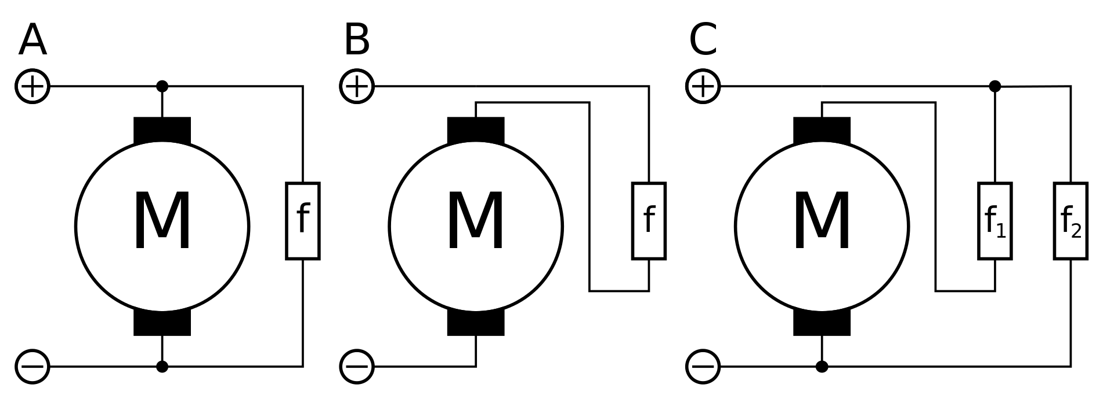

Slide 8


Slide 9

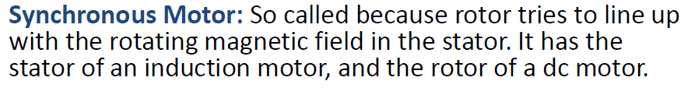
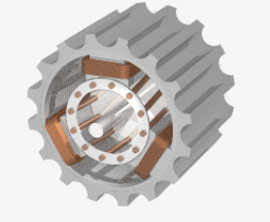

Slide 10
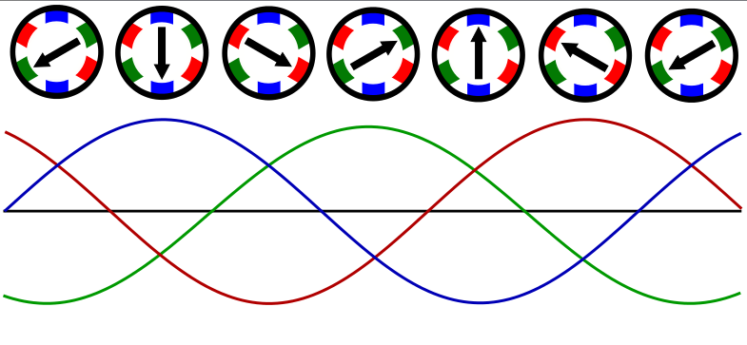

Slide 14
2. Karakteristik Motor Listrik
Characteristics Of DC Motors
Generally, three characteristic curves are considered important for DC motors which are
(i) Torque vs. armature current,
(ii) Speed vs. armature current and
(iii) Speed vs. torque.
These are explained below for each type of DC motor. These characteristics are determined by keeping the following two relations in mind.

Slide 15
Characteristics Of DC Series Motors
Torque Vs. Armature Current (T_{a}-I_{a})
This characteristic is also known as electrical characteristic. We know that torque is directly proportional to the product of armature current and field flux, T_{a} ∝ ɸ.I_{a}. In DC series motors, field winding is connected in series with the armature, i.e. I_{a} = I_{f}. Therefore, before magnetic saturation of the field, flux ɸ is directly proportional to Ia. Hence, before magnetic saturation Ta α Ia². Therefore, the Ta-Ia curve is parabola for smaller values of Ia.
After magnetic saturation of the field poles, flux ɸ is independent of armature current Ia. Therefore, the torque varies proportionally to Ia only, T ∝ Ia.Therefore, after magnetic saturation, Ta-Ia curve becomes a straight line.
The shaft torque (Tsh) is less than armature torque (Ta) due to stray losses. Hence, the curve Tsh vs Ia lies slightly lower.
In DC series motors, (prior to magnetic saturation) torque increases as the square of armature current, these motors are used where high starting torque is required.

Slide 16
Speed Vs. Armature Current (N-Ia)
We know the relation, N ∝ E_{b}/ɸ
For small load current (and hence for small armature current) change in back emf Eb is small and it may be neglected. Hence, for small currents speed is inversely proportional to ɸ. As we know, flux is directly proportional to Ia, speed is inversely proportional to Ia. Therefore, when armature current is very small the speed becomes dangerously high.
That is why a series motor should never be started without some mechanical load. But, at heavy loads, armature current Ia is large. And hence, speed is low which results in decreased back emf Eb. Due to decreased Eb, more armature current is allowed.
Speed Vs. Torque (N-Ta)
This characteristic is also called as mechanical characteristic. From the above two characteristics of DC series motor, it can be found that when speed is high, torque is low and vice versa.

Slide 17
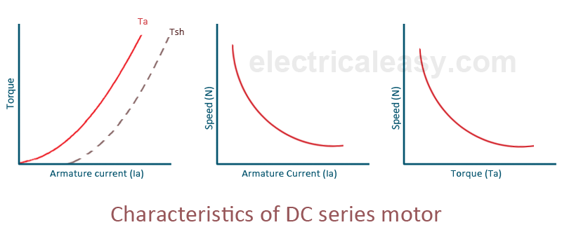

Slide 18

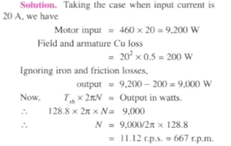
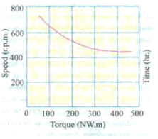
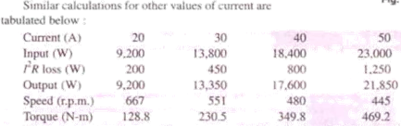

Slide 22
Characteristics Of DC Shunt Motors
Torque Vs. Armature Current (Ta-Ia)
In case of DC shunt motors, we can assume the field flux ɸ to be constant. Though at heavy loads, ɸ decreases in a small amount due to increased armature reaction. As we are neglecting the change in the flux ɸ, we can say that torque is proportional to armature current. Hence, the Ta-Ia characteristic for a dc shunt motor will be a straight line through the origin.
Since heavy starting load needs heavy starting current, shunt motor should never be started on a heavy load.
Speed Vs. Armature Current (N-Ia)
As flux ɸ is assumed to be constant, we can say N ∝ Eb. But, as back emf is also almost constant, the speed should remain constant. But practically, ɸ as well as Eb decreases with increase in load. Back emf Eb decreases slightly more than ɸ, therefore, the speed decreases slightly. Generally, the speed decreases only by 5 to 15% of full load speed. Therefore, a shunt motor can be assumed as a constant speed motor. In speed vs. armature current characteristic in the following figure, the straight horizontal line represents the ideal characteristic and the actual characteristic is shown by the dotted line.

Slide 23
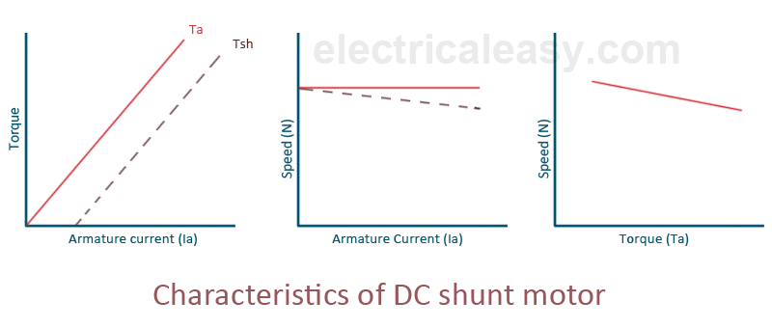

Slide 24
Characteristics Of DC Compound Motor
DC compound motors have both series as well as shunt winding. In a compound motor, if series and shunt windings are connected such that series flux is in direction as that of the shunt flux then the motor is said to be cumulatively compounded. And if the series flux is opposite to the direction of the shunt flux, then the motor is said to be differentially compounded. Characteristics of both these compound motors are explained below.
(a) Cumulative compound motor
Cumulative compound motors are used where series characteristics are required but the load is likely to be removed completely. Series winding takes care of the heavy load, whereas the shunt winding prevents the motor from running at dangerously high speed when the load is suddenly removed. These motors have generally employed a flywheel, where sudden and temporary loads are applied like in rolling mills.

Slide 25
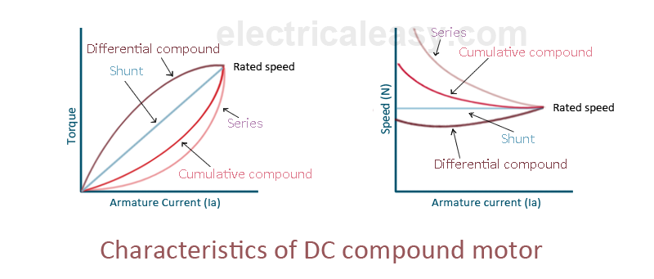
(b) Differential compound motor
Since in differential field motors, series flux opposes shunt flux, the total flux decreases with increase in load. Due to this, the speed remains almost constant or even it may increase slightly with increase in load (N ∝ E_{b}/ɸ). Differential compound motors are not commonly used, but they find limited applications in experimental and research work.

Slide 26
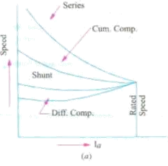
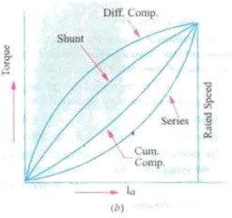

Slide 27



Slide 28
Torque Equation Of Three Phase Induction Motor
Torque of a three phase induction motor is proportional to flux per stator pole, rotor current and the power factor of the rotor.
T ∝ ɸ I₂ cosɸ₂ OR T = k ɸ I₂ cosɸ₂ .
where, ɸ = flux per stator pole,
I₂ = rotor current at standstill,
ɸ₂ = angle between rotor emf and rotor current,
k = a constant.
Now, let E₂ = rotor emf at standstill
we know, rotor emf is directly proportional to flux per stator pole, i.e. E₂ ∝ ɸ.
therefore, T ∝ E₂ I₂ cosɸ₂ OR T =k₁ E₂ I₂ cosɸ₂.

Slide 29


Starting Torque
The torque developed at the instant of starting of a motor is called as starting torque. Starting torque may be greater than running torque in some cases, or it may be lesser.
We know, T =k₁ E₂ I₂ cosɸ₂.
let, R2 = rotor resistance per phase
X2 = standstill rotor reactance
then,
Therefore, starting torque can be given as,

Slide 30

The constant k1 = 3 / 2πNs
Crawling
Sometimes, squirrel cage induction motors exhibits a tendency to run at very slow speeds (as low as one-seventh of their synchronous speed). This phenomenon is called as crawling of an induction motor.
This action is due to the fact that, flux wave produced by a stator winding is not purely sine wave. Instead, it is a complex wave consisting a fundamental wave and odd harmonics like 3rd, 5th, 7th etc. The fundamental wave revolves synchronously at synchronous speed Ns whereas 3rd, 5th, 7th harmonics may rotate in forward or backward direction at Ns/3, Ns/5, Ns/7 speeds respectively. Hence, harmonic torques are also developed in addition with fundamental torque.

Slide 31
3rd harmonics are absent in a balanced 3-phase system. Hence 3rdd harmonics do not produce rotating field and torque. The total motor torque now consist three components as: (i) the fundamental torque with synchronous speed Ns, (ii) 5th harmonic torque with synchronous speed Ns/5, (iv) 7th harmonic torque with synchronous speed Ns/7 (provided that higher harmonics are neglected).
Now, 5th harmonic currents will have phase difference of 5 X 120 = 600° =2 X 360 - 120 = -120°. Hence the revolving speed set up will be in reverse direction with speed Ns/5. The small amount of 5th harmonic torque produces breaking action and can be neglected.
The 7th harmonic currents will have phase difference of 7 X 120 = 840° = 2 X 360 +120 = + 120°. Hence they will set up rotating field in forward direction with synchronous speed equal to Ns/7. If we neglect all the higher harmonics, the resultant torque will be equal to sum of fundamental torque and 7th harmonic torque. 7th harmonic torque reaches its maximum positive value just before1/7 th of Ns. If the mechanical load on the shaft involves constant load torque, the torque developed by the motor may fall below this load torque. In this case, motor will not accelerate upto its normal speed, but it will run at a speed which is nearly 1/7th of of its normal

Slide 32
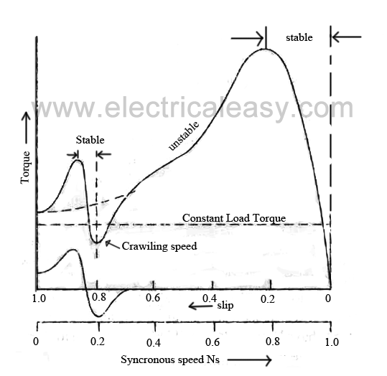
Cogging (Magnetic Locking Or Teeth Locking)
Sometimes, the rotor of a squirrel cage induction motor refuses to start at all, particularly if the supply voltage is low. This happens especially when number of rotor teeth is equal to number of stator teeth,
because of magnetic locking between the stator teeth and the rotor teeth. When the rotor teeth and stator teeth face each other, the reluctance of the magnetic path is minimum, that is why the rotor tends to remain fixed. This phenomenon is called cogging or magnetic locking of induction mo tor.

Slide 33
4 Pengaturan Motor Listrik
Speed Control Methods Of DC Motor
Speed Of A DC Motor
Back emf E_{b} of a DC motor is nothing but the induced emf in armature conductors due to rotation of the armature in magnetic field. Thus, the magnitude of E_{b} can be given by EMF equation of a DC generator.
E_{b} = ^{PØNZ}/_{60A}
(where, P = no. of poles, Ø = flux/pole, N = speed in rpm, Z = no. of armature conductors, A = parallel paths)
E_{b} can also be given as,
E_{b} = V- I_{a}R_{a}

Slide 34
thus, from the above equations
N = ^{E}_{b} ^{60A}/_{PØZ}
but, for a DC motor A, P and Z are constants
Therefore,
N ∝ K ^{E}_{b}/_{Ø} (where, K=constant)
This shows the speed of a dc motor is directly proportional to the back emf and inversely proportional to the flux per pole.

Slide 35
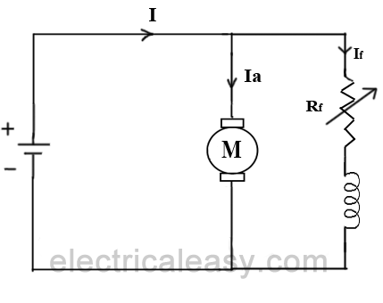
Speed Control Of Shunt Motor
1. Flux Control Method
It is already explained above that the speed of a dc motor is inversely proportional to the flux per pole. Thus by decreasing the flux, speed can be increased and vice versa.
To control the flux, a rheostat is added in series with the field winding, as shown in the circuit diagram.
Adding more resistance in series with the field winding will increase the speed as it decreases the flux. In shunt motors, as field current is relatively very small, I_{sh}²R loss is small. Therefore, this method is quite efficient. Though speed can be increased above the rated value by reducing flux with this method, it puts a limit to maximum speed as weakening of field flux beyond a limit will adversely affect the commutation.

Slide 36
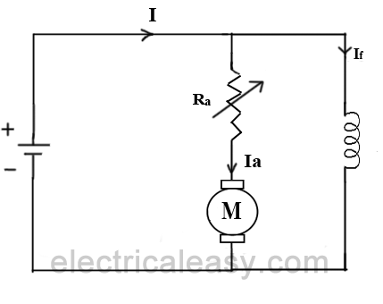
2. Armature Control Method
Speed of a dc motor is directly proportional to the back emf E_{b} and E_{b} = V - I_{a}R_{a}. That means, when supply voltage V and the armature resistance R_{a} are kept constant, then the speed is directly proportional to armature current I_{a}. Thus, if we add resistance in series with the armature, I_{a} decreases and, hence, the speed also decreases. Greater the resistance in series with the armature, greater the decrease in speed.

Slide 37
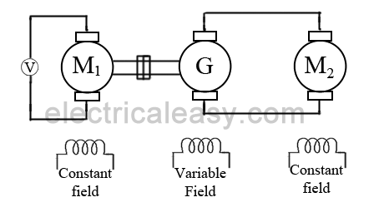
3. Voltage Control Method
a) Multiple voltage control:
In this method, the shunt field is connected to a fixed exciting voltage and armature is supplied with different voltages. Voltage across armature is changed with the help of suitable switchgear. The speed is approximately proportional to the voltage across the armature.
b) Ward-Leonard System:
This system is used where very sensitive speed control of motor is required (e.g electric excavators, elevators etc.). The arrangement of this system is as shown in the figure at right.
M₂ is the motor to which speed control is required.
M₁ may be any AC motor or DC motor with constant speed.

Slide 38
G is a generator directly coupled to M₁.
In this method, the output from generator G is fed to the armature of the motor M₂ whose speed is to be controlled. The output voltage of generator G can be varied from zero to its maximum value by means of its field regulator and, hence, the armature voltage of the motor M₂ is varied very smoothly. Hence, very smooth speed control of the dc motor can be obtained by this method.
Speed Control Of Series Motor
1. Flux Control Method
Field diverter: A variable resistance is connected parallel to the series field as shown in fig (a). This variable resistor is called as a diverter, as the desired amount of current can be diverted through this resistor and, hence, current through field coil can be decreased. Thus, flux can be decreased to the desired amount and speed can be increased.
Tapped field control: As shown in fig (c) field coil is tapped dividing number of turns. Thus we can select different value of Ø by selecting different number of turns.

Slide 39
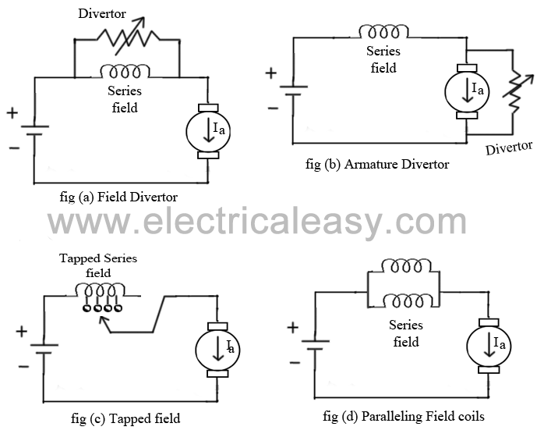
Armature diverter: Diverter is connected across the armature as shown in fig (b).
For a given constant load torque, if armature current is reduced then the flux must increase, as Ta ∝ ØIa
This will result in an increase in current taken from the supply and hence flux Ø will increase and subsequently speed of the motor will decrease.
Paralleling field coils: In this method, several speeds can be obtained by regrouping coils as shown in fig (d).

Slide 40
2. Variable Resistance In Series With Armature
By introducing resistance in series with the armature, voltage across the armature can be reduced. And, hence, speed reduces in proportion with it.
3. Series-Parallel Control
This system is widely used in electric traction, where two or more mechanically coupled series motors are employed. For low speeds, the motors are connected in series, and for higher speeds, the motors are connected in parallel.
When in series, the motors have the same current passing through them, although voltage across each motor is divided. When in parallel, the voltage across each motor is same although the current gets divided.

Slide 41

Speed Control Methods Of Induction Motor
1. By Changing The Applied Voltage:
From the torque equation of induction motor,
Rotor resistance R₂ is constant and if slip s is small then (sX₂)² is so small that it can be neglected. Therefore, T ∝ sE₂² where E₂ is rotor induced emf and E₂ ∝ V
Thus, T ∝ sV², which means, if supplied voltage is decreased, the developed torque decreases. Hence, for providing the same load torque, the slip increases with decrease in voltage, and consequently, the speed decreases. This method is the easiest and cheapest, still rarely used, because
large change in supply voltage is required for relatively small change in speed.
large change in supply voltage will result in a large change in flux density, hence, this will disturb the magnetic conditions of the motor.

Slide 42

2. By Changing The Applied Frequency
Synchronous speed of the rotating magnetic field of an induction motor is given by,
where, f = frequency of the supply and P = number of stator poles.
Hence, the synchronous speed changes with change in supply frequency. Actual speed of an induction motor is given as N = Ns (1 - s). However, this method is not widely used. It may be used where, the induction motor is supplied by a dedicated generator (so that frequency can be easily varied by changing the speed of prime mover). Also, at lower frequency, the motor current may become too high due to decreased reactance. And if the frequency is increased beyond the rated value, the maximum torque developed falls while the speed rises.

Slide 43
3. Constant V/F Control Of Induction Motor
This is the most popular method for controlling the speed of an induction motor. As in above method, if the supply frequency is reduced keeping the rated supply voltage, the air gap flux will tend to saturate. This will cause excessive stator current and distortion of the stator flux wave. Therefore, the stator voltage should also be reduced in proportional to the frequency so as to maintain the air-gap flux constant. The magnitude of the stator flux is proportional to the ratio of the stator voltage and the frequency. Hence, if the ratio of voltage to frequency is kept constant, the flux remains constant. Also, by keeping V/F constant, the developed torque remains approximately constant. This method gives higher run-time efficiency. Therefore, majority of AC speed drives employ constant V/F method (or variable voltage, variable frequency method) for the speed control. Along with wide range of speed control, this method also offers 'soft start' capability.

Slide 44
4. Changing The Number Of Stator Poles
From the above equation of synchronous speed, it can be seen that synchronous speed (and hence, running speed) can be changed by changing the number of stator poles. This method is generally used for squirrel cage induction motors, as squirrel cage rotor adapts itself for any number of stator poles. Change in stator poles is achieved by two or more independent stator windings wound for different number of poles in same slots.
For example, a stator is wound with two 3phase windings, one for 4 poles and other for 6 poles.
for supply frequency of 50 Hz
i) synchronous speed when 4 pole winding is connected, Ns = 120*50/4 = 1500 RPM
ii) synchronous speed when 6 pole winding is connected, Ns = 120*50/6 = 1000 RPM

Slide 45
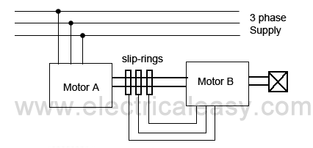
Speed Control From Rotor Side:
1. Rotor Rheostat Control
This method is similar to that of armature rheostat control of DC shunt motor. But this method is only applicable to slip ring motors, as addition of external resistance in the rotor of squirrel cage motors is not possible.
2. Cascade Operation
In this method of speed control, two motors are used. Both are mounted on a same shaft so that both run at same speed. One motor is fed from a 3phase supply and the other motor is fed from the induced emf in first motor via slip-rings. The arrangement is as shown in following figure.

Slide 46
Motor A is called the main motor and motor B is called the auxiliary motor.
Let, N_{s1} = frequency of motor A
N_{s2} = frequency of motor B
P₁ = number of poles stator of motor A
P₂ = number of stator poles of motor B
N = speed of the set and same for both motors
f = frequency of the supply
Now, slip of motor A, S₁ = (N_{s1} - N) / N_{s1}.
frequency of the rotor induced emf in motor A, f₁ = S₁f
Now, auxiliary motor B is supplied with the rotor induce emf
therefore, N_{s2} = (120f₁) / P₂ = (120S₁f) / P₂.
now putting the value of S₁ = (N_{s1} - N) / N_{s1}

Slide 47


At no load, speed of the auxiliary rotor is almost same as its synchronous speed. i.e. N = N_{s2}.
from the above equations, it can be obtained that
With this method, four different speeds can be obtained
1. when only motor A works, corresponding speed = .Ns1 = 120f / P₁
2. when only motor B works, corresponding speed = Ns2 = 120f / P₂
3. if commulative cascading is done, speed of the set = N = 120f / (P₁ + P₂)
4. if differential cascading is done, speed of the set = N = 120f (P₁ - P₂)

Slide 48
3. By Injecting EMF In Rotor Circuit
In this method, speed of an induction motor is controlled by injecting a voltage in rotor circuit. It is necessary that voltage (emf) being injected must have same frequency as of the slip frequency. However, there is no restriction to the phase of injected emf. If we inject emf which is in opposite phase with the rotor induced emf, rotor resistance will be increased. If we inject emf which is in phase with the rotor induced emf, rotor resistance will decrease. Thus, by changing the phase of injected emf, speed can be controlled. The main advantage of this method is a wide rage of speed control (above normal as well as below normal) can be achieved. The emf can be injected by various methods such as Kramer system, Scherbius system etc.

Slide 49
STARTING PADA MOTOR LISTRIK
Starting Methods Of Three Phase Induction Motors
An induction motor is similar to a poly-phase transformer whose secondary is short circuited. Thus, at normal supply voltage, like in transformers, the initial current taken by the primary is very large for a short while. Unlike in DC motors, large current at starting is due to the absence of back emf. If an induction motor is directly switched on from the supply, it takes 5 to 7 times its full load current and develops a torque which is only 1.5 to 2.5 times the full load torque. This large starting current produces a large voltage drop in the line, which may affect the operation of other devices connected to the same line. Hence, it is not advisable to start induction motors of higher ratings (generally above 25kW) directly from the mains supply.
Various starting methods of induction motors are described below.

Slide 50
Direct-On-Line (DOL) Starters
Small three phase induction motors can be started direct-on-line, which means that the rated supply is directly applied to the motor.
But, as mentioned above, here, the starting current would be very large, usually 5 to 7 times the rated current. The starting torque is likely to be 1.5 to 2.5 times the full load torque. Induction motors can be started directly on-line using a DOL starter which generally consists of a contactor and a motor protection equipment such as a circuit breaker.
A DOL starter consists of a coil operated contactor which can be controlled by start and stop push buttons. When the start push button is pressed, the contactor gets energized and it closes all the three phases of the motor to the supply phases at a time. The stop push button de-energizes the contactor and disconnects all the three phases to stop the motor.
In order to avoid excessive voltage drop in the supply line due to large starting current, a DOL starter is generally used for motors that are rated below 5kW.

Slide 51
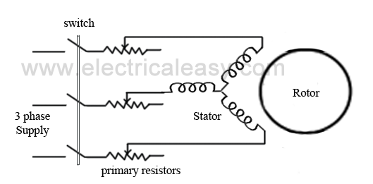
Starting Of Squirrel Cage Motors
Starting in-rush current in squirrel cage motors is controlled by applying reduced voltage to the stator. These methods are sometimes called as reduced voltage methods for starting of squirrel cage induction motors. For this purpose, following methods are used:
By using primary resistors
Obviously, the purpose of primary resistors is to drop some voltage and apply a reduced voltage to the stator. Consider, the starting voltage is reduced by 50%. Then according to the Ohm's law (V=I/Z), the starting current will also be reduced by the same percentage. From the torque equation of a three phase induction motor, the starting torque is approximately proportional to the square of the applied voltage.

Slide 52
That means, if the applied voltage is 50% of the rated value, the starting torque will be only 25% of its normal voltage value. This method is generally used for a smooth starting of small induction motors. It is not recommended to use primary resistors type of starting method for motors with high starting torque requirements.
Resistors are generally selected so that 70% of the rated voltage can be applied to the motor. At the time of starting, full resistance is connected in the series with the stator winding and it is gradually decreased as the motor speeds up. When the motor reaches an appropriate speed, the resistances are disconnected from the circuit and the stator phases are directly connected to the supply lines.

Slide 53
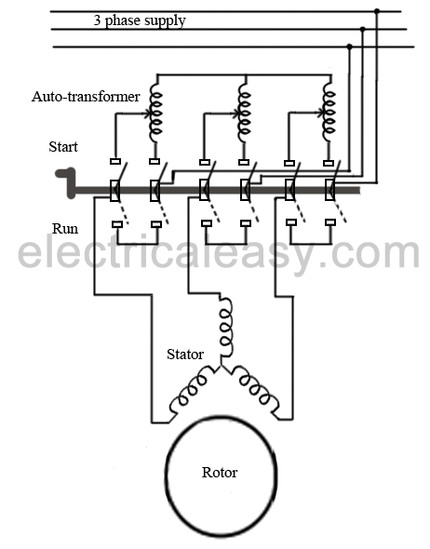
Autotransformer
Auto-transformers are also known as auto-starters. They can be used for both star connected or delta connected squirrel cage motors. It is basically a three phase step down transformer with different taps provided that permit the user to start the motor at, say, 50%, 65% or 80% of line voltage.
With auto-transformer starting, the current drawn from supply line is always less than the motor current by an amount equal to the transformation ratio.
For example, when a motor is started on a 65% tap, the applied voltage to the motor will be 65% of the line voltage and the applied current will be 65% of the line voltage starting value, while the line current will be 65% of 65% (i.e. 42%) of the line voltage starting value. This difference between the line current and the motor current is due to transformer action.

Slide 54
The internal connections of an auto-starter are as shown in the figure. At starting, switch is at "start" position, and a reduced voltage (which is selected using a tap) is applied across the stator. When the motor gathers an appropriate speed, say upto 80% of its rated speed, the auto-transformer automatically gets disconnected from the circuit as the switch goes to "run" position.
The switch changing the connection from start to run position may be air-break (small motors) or oil-immersed (large motors) type. There are also provisions for no-voltage and overload, with time delay circuits on an autostarter.
Star-delta switches
This method is used in the motors, which are designed to run on delta connected stator. A two way switch is used to connect the stator winding in star while starting and in delta while running at normal speed. When the stator winding is star connected, voltage over each phase in motor will be reduced by a factor 1/(sqrt. 3) of that would be for delta connected winding. The starting torque will 1/3 times that it will be for delta connected winding. Hence a star-delta starter is equivalent to an auto-transformer of ratio 1/(sqrt. 3) or 58% reduced voltage.

Slide 55
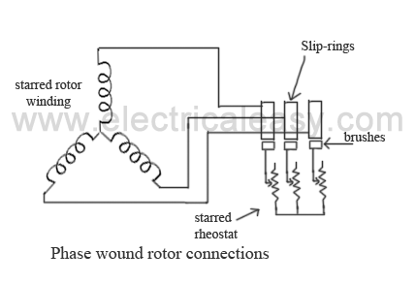
Starting Of Slip-Ring Motors
Slip-ring motors are started with full line voltage, as external resistance can be easily added in the rotor circuit with the help of slip-rings. A star connected rheostat is connected in series with the rotor via slip-rings as shown in the fig.
Introducing resistance in rotor current will decrease the starting current in rotor (and, hence, in stator). Also, it improves power factor and the torque is increased. The connected rheostat may be hand-operated or automatic.
As, introduction of additional resistance in rotor improves the starting torque, slip-ring motors can be started on load.
The external resistance introduced is only for starting purposes, and is gradually cut out as the motor gathers the speed.

Slide 56
Starting Methods Of A DC Motor
Basic operational voltage equation of a DC motor is given as
E = E_{b} + I_{a}R_{a} and hence, I_{a} = (E - E_{b}) / R_{a}
Now, when the motor is at rest, obviously, the back emf E_{b} = 0. Hence, armature current at the moment of starting can be given as I_{a} = E / R_{a}.
In practical DC machines, armature resistance is basically very low, generally about 0.5 Ω. Therefore, a large current flows through the armature during starting. This current is large enough to damage the armature circuit.
Due to this excessive starting current -
the fuses may blow out and the armature winding and/or commutator brush arrangement may get damaged.
very high starting torque will be produced (as torque is directly proportional to the armature current), and this high starting torque may cause huge centrifugal force which may throw off the armature winding.
other loads connected to the same source may experience a dip in the terminal voltage.

Slide 57
A large DC motor will pick up speed rather slowly due to its large rotor inertia. Hence, building up the back emf slowly causing the level of high starting current maintained for quite some time. This may cause severe damage.
To avoid this, a suitable DC motor starter must be used. Very small dc motors, however, may be started directly by connecting them to the supply with the help of a contactor or a switch. It does not result in any harm because they gather speed quickly due to small rotor inertia. In this case, the large starting current will die down quickly because of the fast rise in the back emf.
DC Motor Starters
To avoid the above dangers while starting a DC motor, it is necessary to limit the starting current. So, a DC motor is started by using a starter. There are various types of dc motor starters, such as 3 point starter, 4 point starter, no-load release coil starter, thyristor controller starter etc.
The basic concept behind every DC motor starter is adding external resistance to the armature winding during starting.

Slide 58
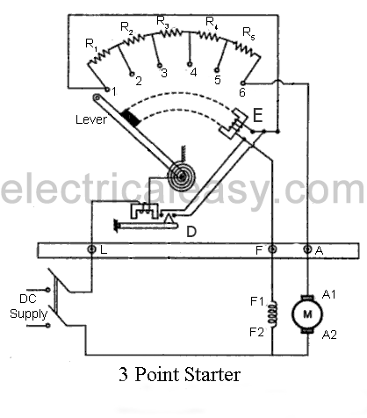
From the followings, 3 point starters and 4 point starters are used for starting shunt wound motors and compound wound motors.
3 Point Starter
The internal wiring of a 3 point starter is as shown in the figure.
When the connected dc motor is to be started, the lever is turned gradually to the right. When the lever touches point 1, the field winding gets directly connected across the supply, and the armature winding gets connected with resistances R1 to R5 in series. During starting, full resistance is added in series with the armature winding. Then, as the lever is moved further, the resistance is gradually is cut out from the armature circuit. Now, as the lever reaches to position 6,
all the resistance is cut out from the armature circuit and armature gets directly connected across the supply. The electromagnet 'E' (no voltage coil) holds the lever at this position.

Slide 59
The electromagnet 'E' (no voltage coil) holds the lever at this position. This electromagnet releases the lever when there is no (or low) supply voltage.
It can be seen that, when the arm is moved from the position 1 to the last position, the starter resistance gets added in series with the field winding. But, as the value of starter resistance is very small as compared to the shunt resistance, the decrease in shunt field current may be negligible. However, to overcome this drawback a brass or copper arc may be employed within a 3 point starter which makes a connection between the moving arm and the field winding, as shown in the figure of 4 point starter below.
When the motor is overloaded beyond a predefined value, 'overcurrent release electromagnet' D gets activated, which short-circuits electromagnet E and, hence, releases the lever and the motor is turned off.

Slide 60
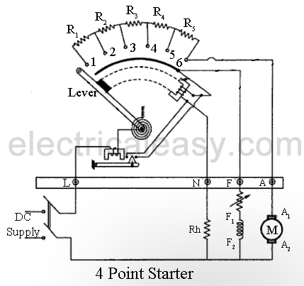
4 Point Starter
The main difference between a 3 point starter and a 4 point starter is that the no voltage coil(electromagnet E) is not connected in series with the field coil. The field winding gets directly connected to the supply, as the lever moves touching the brass arc (the arc below the resistance studs). The no voltage coil (or Hold-on coil) is connected with a current limiting resistance Rh. This arrangement ensures that any change of current in the shunt field does not affect the current through hold-on coil at all. This means, electromagnetic pull of the hold-on coil will always be sufficient so that the spring does not unnecessarily restore the lever to the off position. A 4 point starter is used where field current is to be adjusted by means of a field rheostat for the purpose of operating the motor above rated speed by reducing the field current.

Slide 61
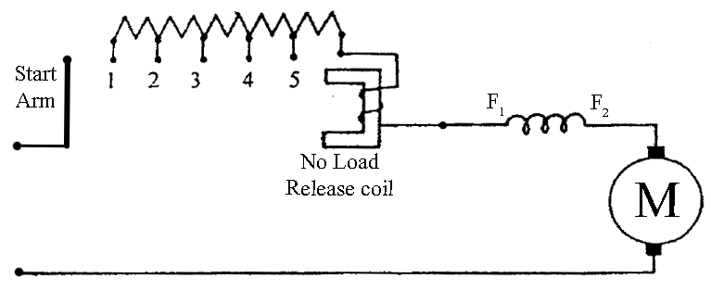
DC Series Motor Starter
Construction of DC series motor starters is very basic as shown in the figure. The start arm is simply moved towards right to start the motor. Thus, maximum resistance is connected in series with the armature during starting and then gradually decreased as the start arm moves towards right. This starter is sometimes also called as a 2 point starter.
The no load release coil holds the start arm to the run position and leaves it when the voltage is lost.

Slide 62
PENGEREMAN PADA MOTOR LISTRIK
Electric Braking Of DC Motors
A running motor may be brought to rest quickly by either mechanical braking or electrical braking. The mechanical braking is applied by means of mechanical break shoes. Hence the smoothness of mechanical braking is dependent on the surface and physical condition of brakes. Smooth braking of a motor can be achieved by electric braking.
Electric Braking
The electric braking of a DC motor is of three types,
(i) Rheostatic or dynamic braking
(ii) Plugging or reverse current braking and
(iii) Regenerative beaking.

Slide 63
(i) Rheostatic or dynamic braking:
In case of DC shunt motors, armature is disconnected from the supply and a rheostat (variable resistor) is connected across it. The field winding is left connected across the supply. Obviously, now armature is driven by the inertia and hence machine starts acting as a generator. Thus the machine will now feed the current to the connected rheostat and heat will dissipate at the rate of I²R. Braking effect is controlled by varying the resistance connected across the armature.
In case of DC series motor, motor is disconnected from the supply and field connections are reversed and a rheostat is connected in series. The field connections are reversed to make sure that the current through field winding will flow in the same direction as before.

Slide 64
(ii) Plugging or Reverse current braking:
In this method, armature connections are reversed and hence motor tends to run in opposite direction. Due to reversal of the armature terminals, applied voltage V and back emf Eb starts acting in the same direction and hence the total armature current exceeds. To limit this armature current a variable resistor is connected across the armature. This is similar for both series and shunt wound methods.
Plugging gives greater braking torque as compared to rheostatic braking. This method is generally used in controlling elevators, machine tools, printing presses etc.
(iii) Regenerative braking:
Regenerative braking is used where, load on the motor has very high inertia (e.g in electric trains). When applied voltage to the motor is reduced to less than back emf Eb, obviously armature current Ia will get reversed, and hence armature torque is reversed. Thus speed falls. As generated emf is greater than applied voltage (machine is acting as a DC generator), power will be returned to the line, this action is called as regeneration. Speed keeps falling, back emf Eb also falls until it becomes lower than applied voltage and direction of armature current again becomes opposite to Eb.

Slide 65

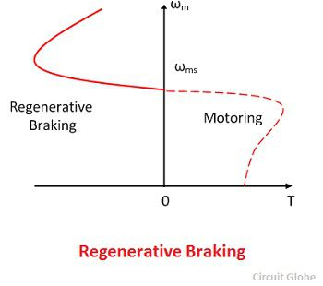
Induction Motor Braking
Regenerative Braking
The input power of the induction motor drive is given by the formula shown below
Where φ_{s} is the phase angle between stator phase voltage and the stator phase current I_{s}. For motoring operation, the phase angle is always less than the 90º. If the rotor speed becomes greater than synchronous speed, then the relative speed between the rotor conductor and air gap rotating field reverse.

Slide 66
This reverse the rotor induces emf, rotor current and component of stator current which balances the rotor ampere turns. When the φ_{s} is greater than the 90º, then the power flow to reverse and gives the regenerative braking. The magnetising current produced the air gap flux.
The nature of the speed torque curve is shown in the figure above. When the supply frequency is fixed, the regenerative braking is possible only for speeds greater than synchronous speed. With a variable frequency speed, it cannot be obtained for speed below synchronous speed.
The main advantage of regenerative braking is that the generated power is fully used. And the main drawback is that when fed from a constant frequency source the motor can not employ below synchronous speed.

Slide 67
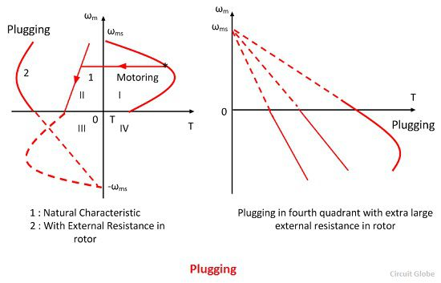
Plugging
When the phase sequence of supply of the motor running at speed is reversed by interchanging the connection of any two phases of the stator on the supply terminal, operation change from motoring to plugging as shown in the figure below. Plugging is the extension of motoring characteristic for a negative phase sequence from quadrant third to second. The reversal of phase sequence reverses the direction of a rotating field.

Slide 68
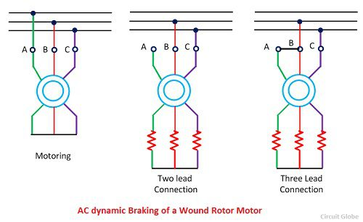
Dynamic Braking
AC Dynamic Braking – The dynamic braking is obtained when the motor is run on the single phase supply by disconnecting the one phase from the source and either leaving it open or connecting it with another phase. The two connections are respectively known as two and three lead connection.

Slide 69

When connected to a one phase supply the motor can be considered as to be fed by positive and negative sequence three phase set of voltage. The total torque produced by the machine is the sum of torque due to positive and negative sequence voltage. When the rotor has high resistance, then the net torque is negative, and the braking operation is obtained.
Assume the phase A of the star connected motor is open circuited. Then the current flow through the phase A becomes zero, i.e., I_{a} = 0 and current through the other two phases is I_{B} = – I_{C}.
The positive and negative sequence component I_{p} and I_{n} are represented by the equation.
Where α = e^{j20°}

Slide 70
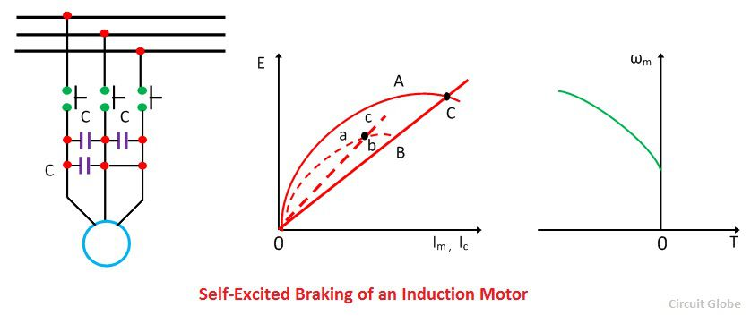
Self Excited Braking Using Capacitor – In this method the three capacitors are permanently connected to the motor. The value of the capacitor is so chosen that when disconnecting from the line, the motor works as a self-excited induction generator. The braking connection and self-excitation process is shown in the figure below.
The curve A is the no load magnetisation curve and line B represent the current through the capacitor. E is the stator induced voltage per phase of the line. The capacitor supplies the necessary reactive current for excitation.

Slide 71
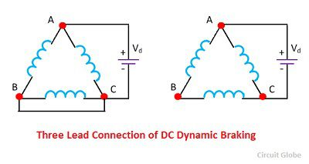
DC Dynamic Braking – In this method, the stator of induction is connected across the DC supply. The method for getting DC supply with the help of a diode bridge is shown in the figure below.
The direct current flow through the stator produces a stationary magnetic field, and the motion of the rotor in this field produces induces voltage in the stationary windings. The machine therefore works as a generator and the generated energy is dissipated in the rotor circuit resistance, thus giving the dynamic winding.

Slide 72
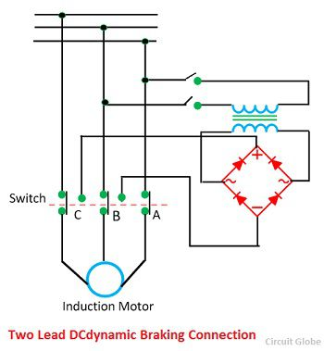

Slide 73
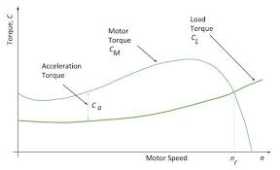

Slide 74
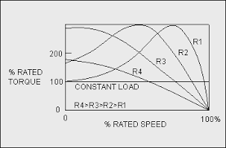
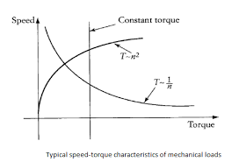
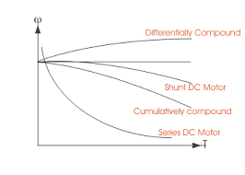
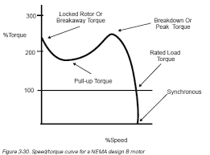
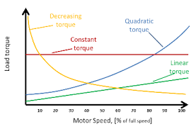

Slide 75
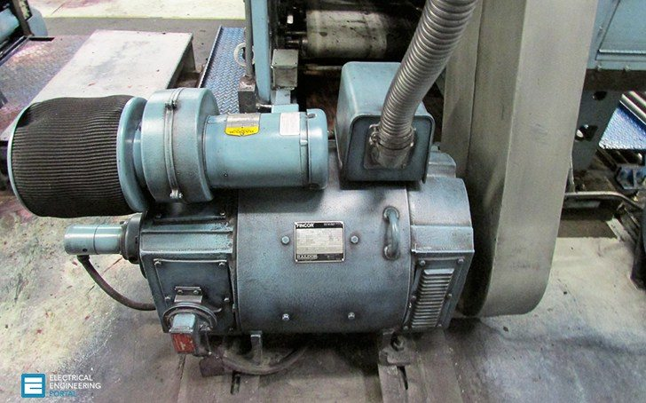
Step 1: Know the load characteristics
For line-operated motors, loads fall into three general categories: constant torque, torque that changes abruptly, and torque that change gradually over time. Bulk material conveyors, extruders, positive displacement pumps, and compressors without air unloaders run at relatively steady levels of torque.
Sizing a motor for these applications is simple once the torque (or horsepower) for the application is known. Load demands by elevators, compactors, punch presses, saws, and batch conveyors change abruptly from low to high in a short time, often in a fraction of a second.

Slide 76
Loads from centrifugal pumps, fans, blowers, compressors with unloaders, and similar equipment tend to be variable over time. In choosing a motor for these conditions, consider the highest continuous load point, which typically occurs at the highest speed.
Step 2: Get a handle on horsepower
The rule of thumb for motor horsepower is: Select only what you need, and avoid the temptation to oversize or undersize. Calculate the required horsepower from this formula:
Horsepower = Torque x Speed / 5250
Where torque is in lb-ft and speed is in rpm.
Step 3: Getting started
Another consideration is inertia, particularly during startup. Every load represents some value of inertia, but punch presses, ball mills, crushers, gearboxes that drive large rolls, and certain types of pumps require high starting torques due to the huge mass of the rotating elements.

Slide 77
Motors for these applications need to have special ratings so that the temperature rise at startup does not exceed the allowable temperature limit. A properly sized motor must be able to turn the load from a dead stop (locked-rotor torque), pull it up to operating speed (pull-up torque), and then maintain the operating speed.
Motors are rated as one of four “design types” for their ability to endure the heat of that starting and pull up.
In ascending order of their ability to start inertial loads, NEMA designates these as design type A, B, C, and D. Type B is the industry standard and is a good choice for most commercial and industrial applications.
Step 4: Adjust for duty cycle
Duty cycle is the load that a motor must handle over the period when it starts, runs, and stops.
Continuous duty
Continuous duty is by far the simplest and most efficient application. The duty cycle begins with startup, then long periods of steady operation where the heat in the motor can stabilize as it runs.
A motor in continuous duty can be operated safely at or near its rated capacity because the temperature has a chance to stabilize.

Slide 78
Intermittent duty
Intermittent duty is more complicated. The life of commercial airplanes is measured by their number of landings; in the same way, the life of a motor is proportional to the number of starts it makes. Frequent starts shorten life because inrush current at startup heats the conductor rapidly.
Because of this heat, motors have a limited number of starts and stops that they can make in an hour
Step 5: The last consideration, motor hypoxia
If your motor is going to operate at altitudes that are substantially above sea level, then it will be unable to operate at its full service factor because, at altitude, air is less dense and does not cool as well. Thus, for the motor to stay within safe limits of temperature rise, it must be derated on a sliding scale.
Up to an altitude of 3,300 ft, SF = 1.15; at 9000 ft, it declines to 1.00.

Slide 88
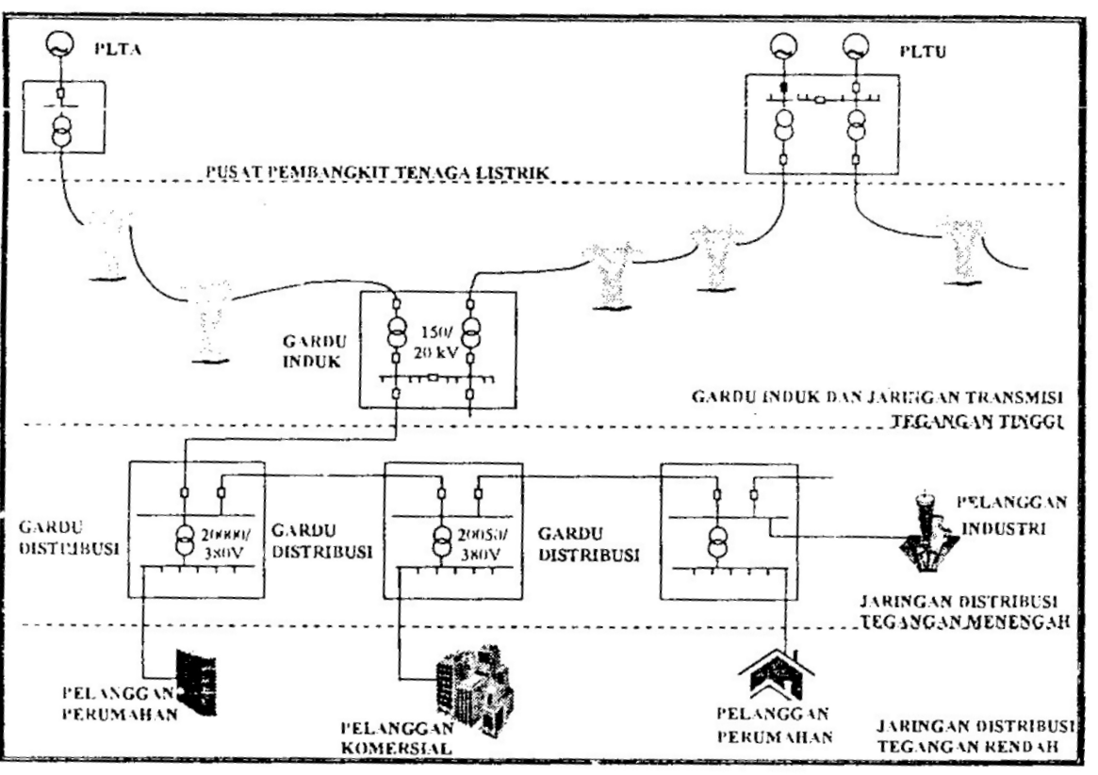
1. PENDAHULUAN
1. 1 UMUM
Sistem tenaga listrik dapat dikelompokkan atas tiga komponen utama
Sistem Pembangkit
Sisten Transmisi
Sistem Distribusi

Slide 89
1. 1. 1 Pusat Pembangkit
Sistem pembangkitan terdiri atas unit – unit pembangkit yang umumnya tersebar luas pada daerah pelayanan sistem interkoneksi
Stasiun pembangkit umumnya terdiri lebih dari satu unit pembangkit
Berdasarkan bahan masukan energi primer, pembangkit dapat dibedakan menjadi:
pusat listrik tenaga diesel-PLTD
pusat listrik tenaga uap-PLTU
pusat listriktenaga air-PLTA
pusat listrik tenaga Nuklir
pusat listrik tenaga angin dan ombak laut
pusat listrik tenaga Nuklir

Slide 90
1. 1. 2 Sistem Transmisi
Sebelum energi listrik ditransmisikan maka hal pertama yang dilakukan adalah menaikkan tegangan generator .
Di Indonesia level tegangan Transmisi adalah 70kV, 150 kV dan 500 kV.
Di samping saluran udara tegangan tinggi terdapat pula saluran tegangan tinggi bawah tanah
Sering pula interkoneksi antara dua sistem pada pulau-pulau yang berbeda dilakukan dengan menggunakan kabel dibawah laut yang sering disebut sebagai submarine cable.
Gardu induk digunakan pula sebagai tempat transit daya listrik dari satu penyulang ke penyulang lain sehingga dapat juga disebut sebagai gardu atau tempat interkoneksi

Slide 91
Terdapat berbagai macam jenis Gardu yang bisa dikategorikan menurut:
Level tegangannya
Fungsinya
Sistem konfigurasinya.
Terdapat dua jenis Gardu Induk, yaitu:
Indoor atu Outdoors
1.1.3 Sistem Distribusi
Sistem distribusi tenaga listrik meliputi semua jaringan tegangan menengah 20 kV dan semua jaringan tegangan rendah 380/220 V hingga meter-meter pelanggan
Para pelanggan listrik dilayani dengan menarik kabel tegangan rendah atau dapat juga dilayani secara khusus dengan menggunakan jaringan tegangan menengah baik 150kV ataupun dengan jaringan tegangan 20kV

Slide 92
Terdapat beberapa sistem jaringan distribusi antara lain:
Radial
Loop
Spindle
Sejalan perkembangan teknologi, pengelolaan dan pengaturan sistem tenaga listrik mulai dari pembangkitan, transmisi dan distribusi semakin berkembang
Sistem pengaturan berkembang mulai dari sistem pengaturan :
konvensional, tiap-tiap subsistem butuh operator
berbasis komputer agar sistem konvensional tersebut dapat dipantau dan diawasi
terintegrasi dimana sub sistem tidak memerlukan operator lagi, yang berarti fungsi operator diambil alih sepenuhnya oleh eperator control centre
Pengendalian sistem tenaga dengan menggunakan:
static compersator
load frequancy control
automatic generation control,

Slide 93
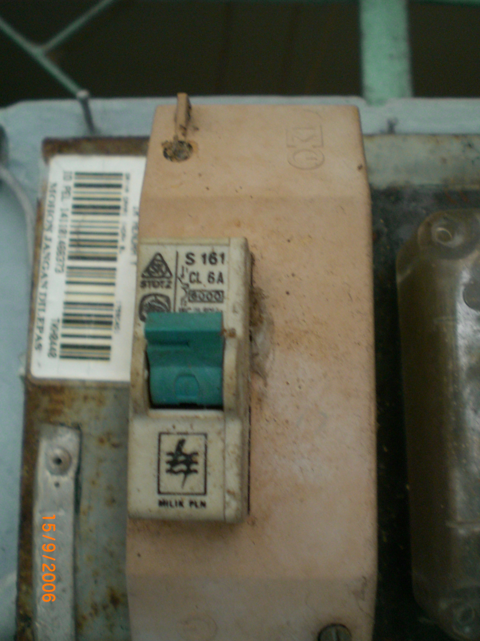

Slide 94
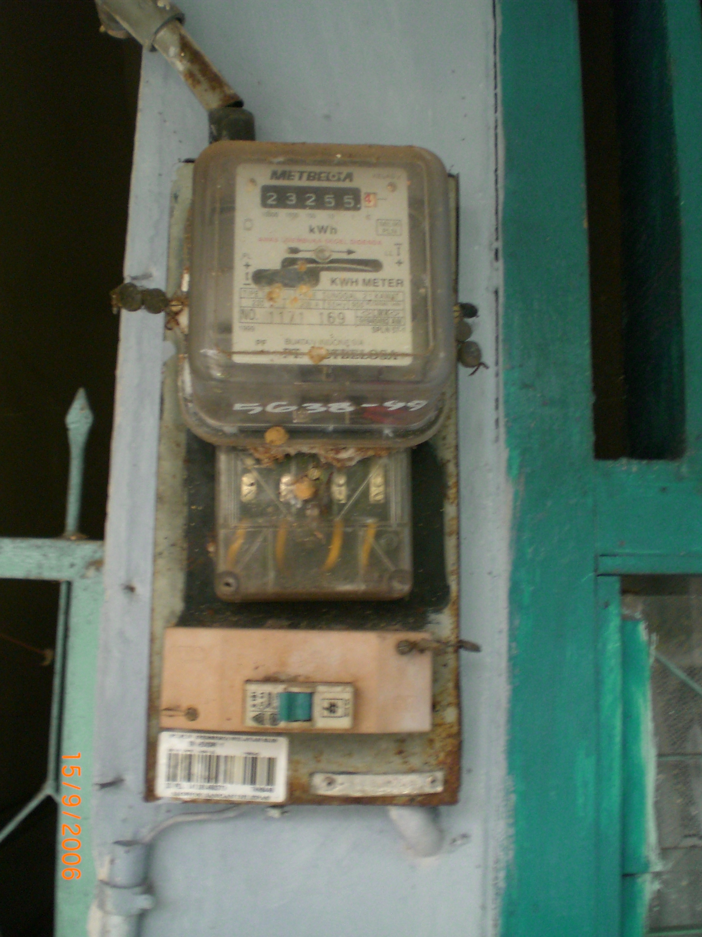

Slide 95
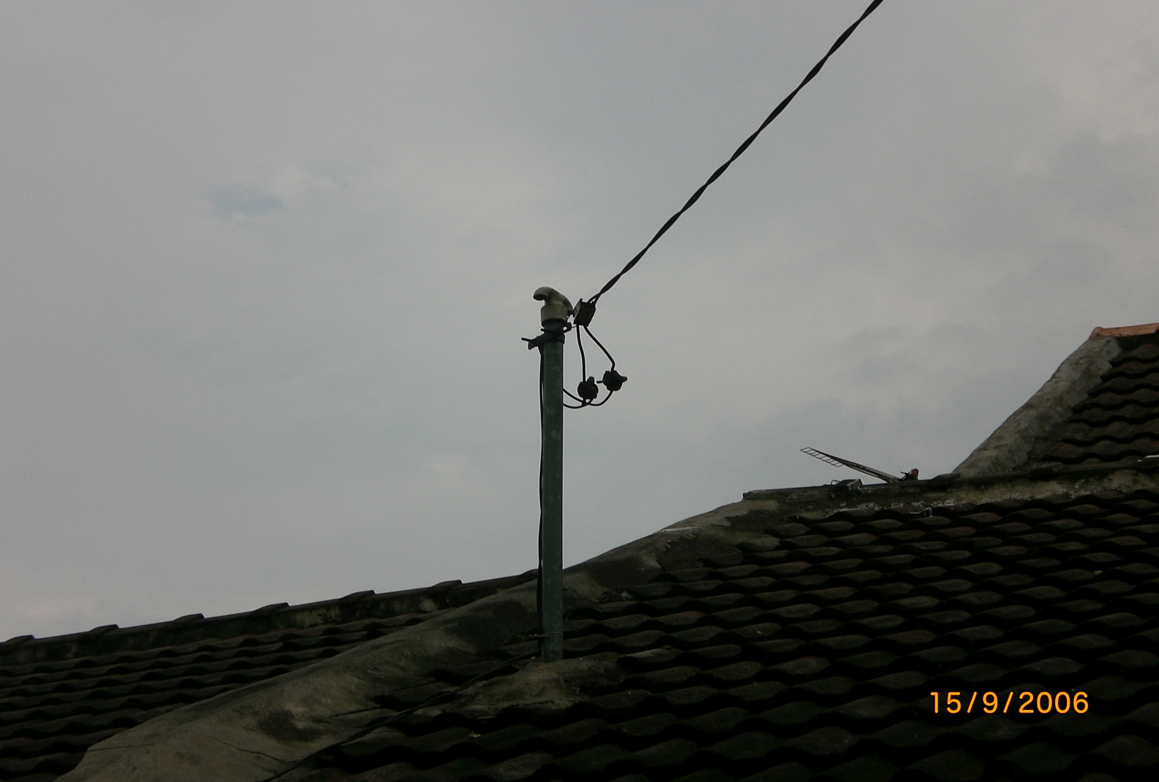

Slide 96
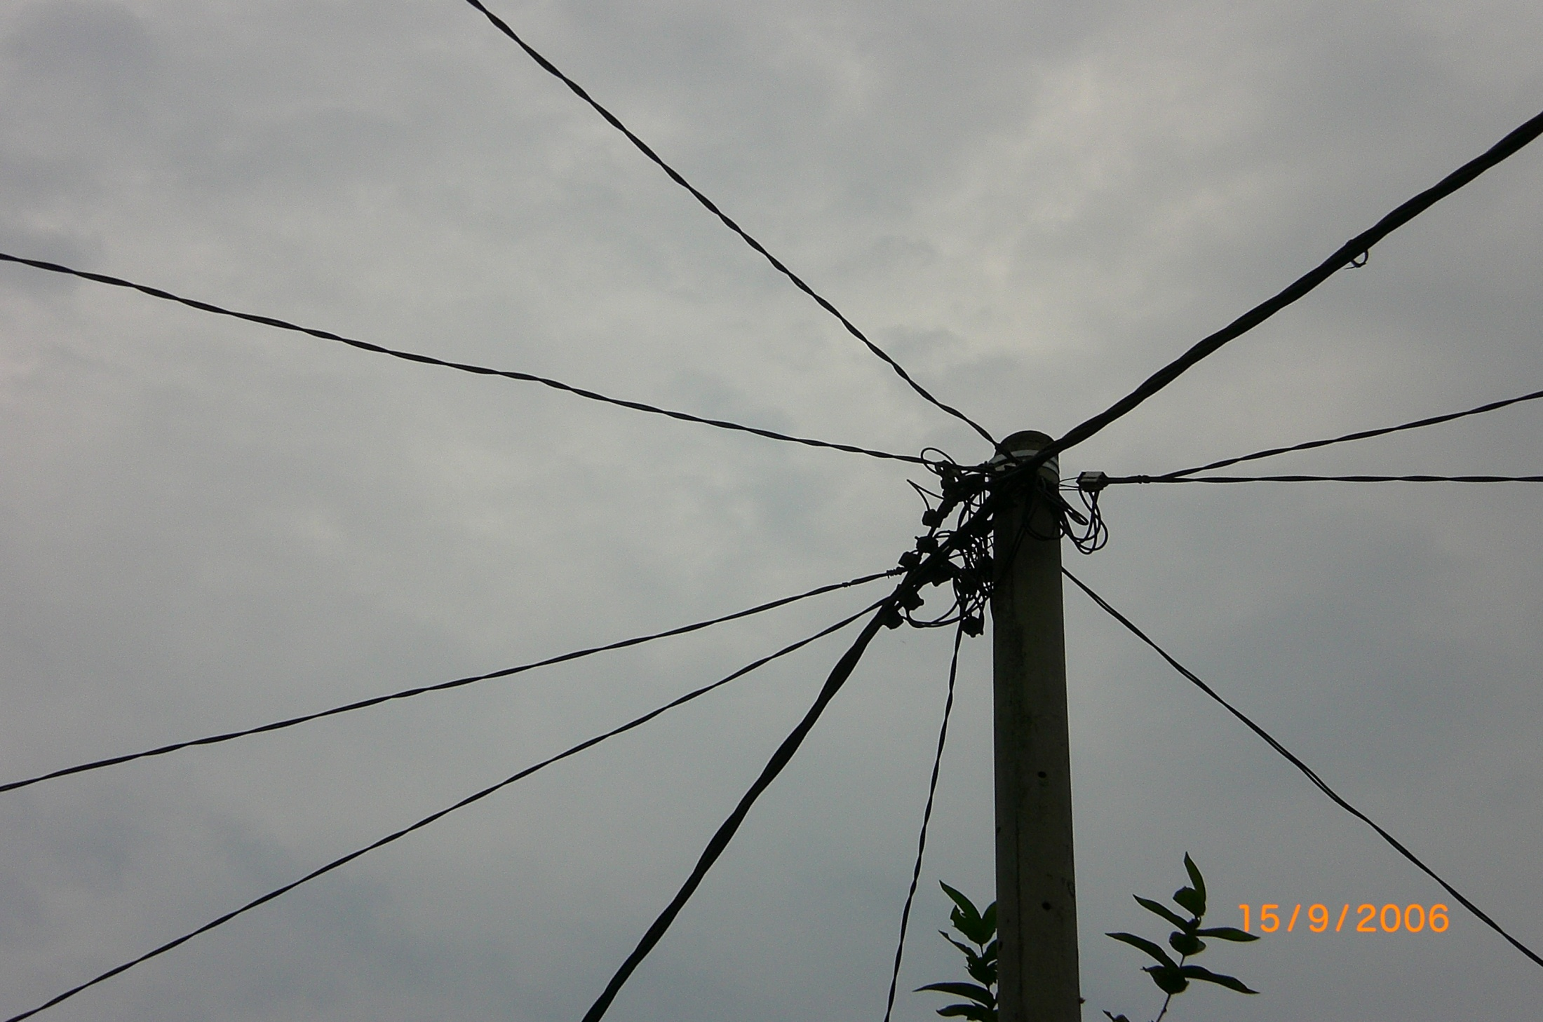

Slide 97


Slide 98
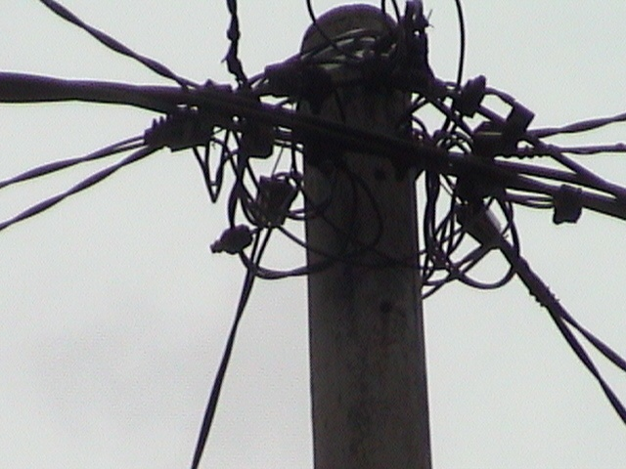

Slide 99


Slide 100


Slide 101
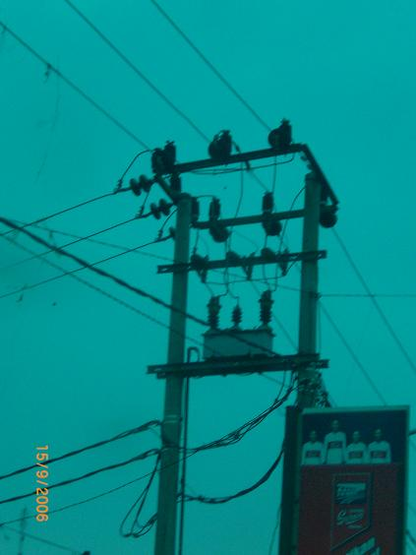

Slide 102


Slide 103
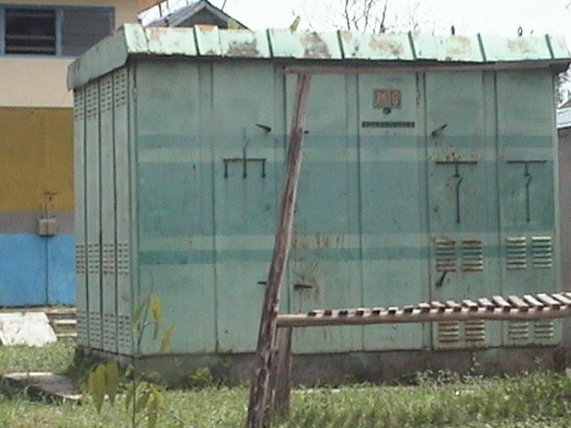

Slide 104
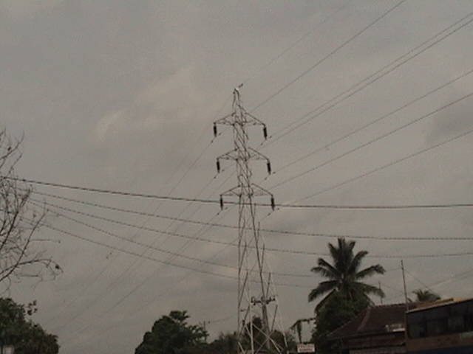

Slide 105


Slide 106
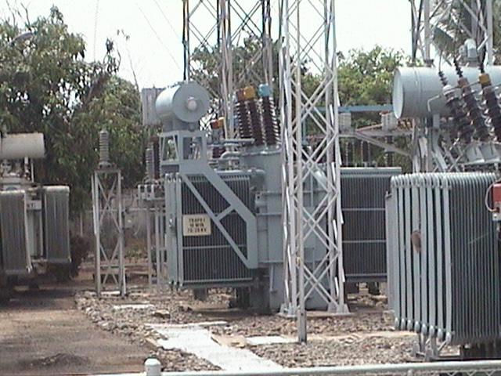

Slide 107
2. KUANTITAS LISTRIK FUnDAMENTAL
DEFINISI DAN PARAMETER RANGKAIAN
A. Satuan Dasar
Dalam sistem ketenaga listrikan digunakan satuan dasar sistem SI
panjang → meter (m)
berat → kilogram (kg)
waktu → detik (s)
besaran dasar sistem kelistrikan untuk arus adalah ampere (A)
didefinisikan memakai terminologi Gaya (F)
F : Gaya (N/m)
d : Jarak antar konduktor (m)
I/I’ : Arus pada setiap konduktor (A)
2 x 10-7 N/m
K : Konstanta, k = µ0/2π

Slide 108
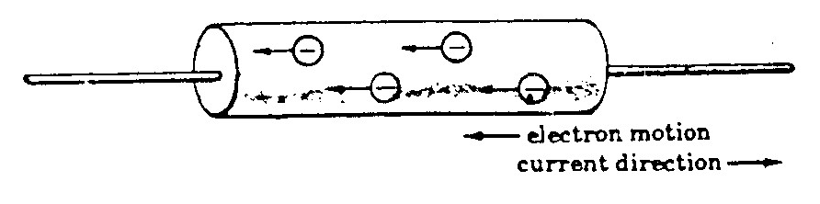
Arah aliran arus berdasarkan konvensi berlawanan dengan arah aliran elektron
B. Muatan, q
Relasi arus dan muatan dapat dituliskan sebagai berikut:

Slide 109
Gaya antara dua muatan q dan q’ yang terpisah sejauh d, dapat dinyatakan dalam hukum Coulomb sebagai berikut:
C. Beda Potensial, V
Beda potensial (v) antara dua titik diukur berdasarkan berapa besar kerja (Usaha) yang dibutuhkan untuk memindahkan satu satuan muatan dari satu titik ke titik lain

Slide 110
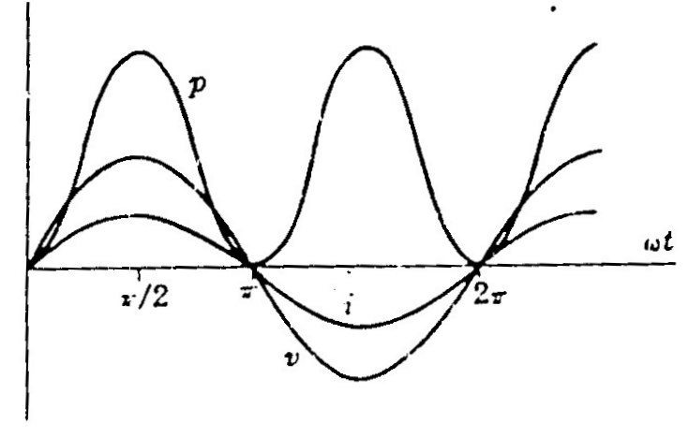
D. Daya, p
Daya listrik p merupakan hasil perkalian antara tegangan v, dan arus i, sebagai berikut:
p (Watt) = v (Volt) x i (Ampere)
daya rata-rata P adalah sebagai berikut:

Slide 111
E. Energi, W
Daya, p adalah perubahan energi persatuan waktu, atau:
energi dapat dinyatakan sebagai berikut:

Slide 112

F. Tahanan,
Induktor
dan Kapasitor
Bila energi listrik diberikan pada suatu sirkit elektrik
sirkit tersebut akan
bereaksi dengan salah satu atau beberapa cara dari tiga cara berikut
energi dikonsumsi →
sirkit tersebut adalah tahanan murni
energi disimpan dalam medan magnetik →
induktor murni
energi tersebut disimpan dalam medan listrik →
kapasitor murni
Resistor, R
dan

Slide 113

Induktor, L
dan
Bilamana v dalam Volt, dan di/dt dalam ampere/detik, maka satuan bagi L adalah volt-detik/ampere atau henry

Slide 114

Kapasitor, C
Muatan q dalam Coulomb dan v dalam volt, C dalam Coulomb/volt atau Farad

Slide 115


2. 2 HUKUM KIRCHHOFF
Jumlah arus yang menuju suatu titik cabang sama dengan jumlah arus yang meninggalkan cabang tersebut. Jika arus menuju titik cabang dinyatakan positif, maka yang meninggalkan titik cabang bertanda negatif. Dengan demikian jumlah arus pada titik cabang tersebut adalah NOL

Slide 116


Jumlah potensial rises dari sebuah sirkit tertutup sama dengan jumlah potensial drop pada sitkit tersebut. Dengan katalain, jumlah aljabar dari potensial yang mengelilingi sirkit tersebut sama dengan NOL

Slide 117



3. HARGA EFEKTIF DAN RATA-RATA
BENTUK GELOMBANG
Beberapa fungsi priodik

Slide 118


Fungsi tegangan dan arus, v dan i adalah ekspresi matematis yang dapat
diberikan dalam beberapa bentuk
fungsi sinus
fungsi cosinus
HARGA RATA-RATA
Fungsi umum y(t) dengan prioda T, memiliki harga rata-rata Y_{AV} sebagai berikut

Slide 119
HARGA EFEKTIF ATAU ROOT MEAN SQUARE
Fungsi umum y(t) dengan prioda T, mempunyai harga efekti Y_{rms} sebesar
Harga efektif dari fungsi
a sin ωt
dan
a cos ωt
adalah

Slide 120

4. TEGANGAN DAN ARUS SINUSOIDAL
Resistor, R
dan
bilamana
maka

Slide 121

Induktor, L
dan
bilamana
maka

Slide 122

Kapasitor, C
bilamana
maka

Slide 123
IMPEDANSI Z
Impedansi sebuah elemen, cabang, atau sebuah rangkaian adalah ratio antara tegangan dan arus
Dengan tegangan dan arus sinusoidal ratio ini akan menghasilkan sebuah magnitude dan sudut
Sudut antara v dan i dikenal dengan sudut phasa,
atau
radian.
SUDUT PHASA
Jika tegangan dan arus keduanya fungsi sinusoidal dipetakan pada skala waktu yang sama, maka akan terlihat pergeseran (perbedaan) antara keduanya, kecuali untuk sirkuit tahanan murni.
Perbedaan ini disebut sudut phasa dan tidak pernah lebih dari 90 atau

Slide 124

Tahanan Murni, R

Slide 125
Induktor Murni, L
Arus tertinggal dari tegangan sebesar 90
atau
Magnitude impedansi adalah

Slide 126
Kapasitor Murni, C
Arus terdahulu oleh tegangan sebesar 90⁰
atau
Magnitud impedansi adalah

Slide 127

RL Seri
Arus tertinggal dari tegangan sebesar
Magnitude Impedansi adalah

Slide 128

RC Seri
Arus terdahulu dari tegangan sebesar
Magnitude Impedansi adalah

Slide 129

RANGKAIAN SERI DAN PARALEL
Untuk elemen-elemen rangkaian yang terhubung secara seri, tegangan total adalah jumlah tegangan jatuh pada masing-masing elemen adalah
Bilamana elemen seri tersebut adalah R, L dan C, maka tegangan total adalah

Slide 130
Bilamana elemen-elemen tersebut terhubung paralel maka total arus pada sirkuit tersebut adalah jumlah arus masing-masing cabang, yaitu:

Slide 131

5. BILANGAN KOMPLEKS
BILANGAN REAL
Sistim bilangan real terdiri dari bilangan
rasional dan irrasional
,
BILANGAN IMAGINER
,
Akar-akar dari bilangan real negative disebut bilangan imajiner murni yaitu :
, dst.
Bila kita menyatakan
maka

Slide 132
Hal ini berlaku untuk
BILANGAN KOMPLEKS
Bilangan kompleks adalah sebuah bilangan dalam bentuk x+jy
x adalah bilangan real
jy disebut bilangan imajiner
Sebuah bilangan kompleks termasuk semua bilangan real dan imajiner dan dapat digambarkan dalam satu sumbu

Slide 133


Slide 134

BENTUK LAIN BILANGAN KOMPLEK
Bilamana
dan bilangan kompleks Z adalah:
dimana
disebut modulus atau harga absolute dari Z
dan sudut
disebut amplitude atau argumen Z
Seperti dalam Gambar untuk Z = 5 + j10, maka
Z = 11,16 (Cos 63,4⁰+ jSin 63,4⁰)

Slide 135
Formula Euler
memungkinkan bentuk lain dari bilangan kompleks yang disebut bentuk eksponensial:
Bentuk polar atau sket steinmentz dari sebuah bilangann kompleks Z yang pemakaiannya sangat luas dalam analisis rangkaian ditulis sbb:
dimana
selalu dalam derajat
Keempat bentuk bilangan kompleks dapat dicari dari salah satu bentuk lainnya, yaitu:

Slide 136
Rektanguler
Polar atau Steinmenz
Eksponensial
Trigonometrik

Slide 137
KONJUGATE BILANGAN KOMPLEKS
Konjugate
bilangan kompleks
adalah bilangan kompleks
Untuk bentuk-bentuk bilangan kompleks lain dan konjugatnya adalah
Rektanguler
Polar atau Steinmenz
Eksponensial
Trigonometrik

Slide 138
OPERASI BILANGAN KOMPLEKS
Penjumlahan dan Pengurangan Bilangan Kompleks
Untuk menjumlahkan bilangan kompleks, tambahkan masing-masing bagian secara terpisah
, demikian pula untuk pengurangan
perkurangan masing2
bagian secara terpisah seperti contoh berikut

Slide 139
Perkalian Bilangan Kompleks
Perkalian dua bilangan kompleks bila keduanya dalam bentuk bilangan eksponensial mengikuti aturan bilangan eksponen
Demikian pula bila dalam bentuk polar
untuk bentuk rectangular

Slide 140
Pembagian Bilangan Kompleks
Pembagian dua bilangan kompleks bila keduanya dalam bentuk bilangan eksponensial mengikuti aturan bilangan eksponen
Demikian pula bila dalam bentuk polar
untuk bentuk rectangular

Slide 141

IMPEDANSI KOMPLEKS DAN NOTASI PHASOR
IMPEDANSI KOMPLEK
Menurut Hukum Kirchhoff, berlaku:
Persamaan diferensial orde satu ini memiliki penyelesaian dalam bentuk arus

Slide 142
Substitusi persamaan arus kedalam persamaan tegangan
Dari persamaan diatas dapat ditentukan bahwa

Slide 143

Ratio fungsi tegangan dan fungsi arus memperlihatkan bahwa impedansi yang ada
lihat rangkaian seri RC
Menurut Hukum Kirchhoff, berlaku:
Persamaan diferensial orde satu ini memiliki penyelesaian dalam bentuk arus

Slide 144
Substitusi persamaan arus kedalam persamaan tegangan
Dari persamaan diatas dapat ditentukan bahwa

Slide 145
mengingat
maka
Ratio fungsi tegangan dan fungsi arus memperlihatkan bahwa impedansi yang ada

Slide 146

NOTASI PHASOR
Tinjau fungsi
Besaran ini adalah besaran komplek
yang mengandung variabel t, meskipum besaran absolute r tetap
Bilamana beberapa sketsa kita gambarkan untuk berbagai harga t

Slide 147


Slide 148

Pada bagian sebelumnya kita telah melihat sebuah rangkaian seri terdiri dari
elemen RL
dengan catuan tegangan
maka akan mengalir arus sebesar
maka notasi phasor dari tegangan dan arus tersebut dapat digambarkan seperti pada Gambar berikut ini:

Slide 149


Slide 152
DAYA, FAKTOR DAYA
DAYA RATA-RATA, P
p = v i = V_{m} I_{m} (sin ωt) (sin ωt – π/2)
mengingat bahwa:
sin (ωt – π/2) = - cos ωt
2 sin x cos x = 2 sin x
diperoleh:
p = v i = - ½ V_{m} I_{m} sin 2ωt

Slide 153


Slide 154


Rangkaian Resistif
Rangkaian Kapasitif

Slide 155
kasus umum
v = V_{m} sin ωt
i = I_{m} sin(ωt + φ)
Daya yang mengalir dalam rangkaian
p = v i = V_{m} I_{m} (sin ωt) (sin ωt + φ)
mengingat bahwa
sin A sin B = ½[cos (A – B) – cos (A + B)]
cos – A = cos A
Harga daya rata-rata P adalah
P = ½ V_{m} I_{m} cos φ = V I cos φ

Slide 156


Slide 157
DAYA SEMU, S
Perkalian VI disebut dengan daya semu, dinyatakan menggunakan simbol S. Satuan daya semu adalah VA dan kVA
DAYA REAKTIF, Q
Perkalian VI sin φ disebut dengan daya reaktif, dinyatakan menggunakan
simbol Q. Satuan daya aktif adalah VAR dan kVAR
SEGITIGA DAYA
S = V I
P = V I cos φ
Q = V I sin φ

Slide 158
SEGITIGA DAYA
I cos φ
φ
V
φ
I sin φ
I
I
P = V I cos φ
φ
Q = V I sin φ
Lagging
S = V I

Slide 159
SEGITIGA DAYA
I
I
I sin φ
φ
φ
I cos φ
V
S = V I
Q = V I sin φ
Leading
φ
P = V I cos φ

Slide 160
Ketiga sisi, S, P dan Q dari segitiga daya dapat dicari dari perkalian antara VI*
Bilamana
V = Ve^{jα} dan I = I^{ej(α+φ)}
maka
S = V I*
S = Ve^{jα} I = Ie^{j-(α+φ)}
S = VI cos φ – j sin φ
S = P – jQ

Slide 161
TERIMA KASIH
atas perhatiannya

